Slide 1

              FACET
              Faculty Assignments Commitments & Effort Certification Tracking
              Exempt and Non-Exempt Effort Certification Overview

Slide 2
Contents
FACET Exempt Effort Reporting
  Overview
  Preparing for Certification
  Effort Certification Process
  Issues Resolution
FACET Non-Exempt Effort Reporting
  Differences from Exempt

Slide 3
FACET Exempt Effort Reporting overview

Slide 4
Exempt Effort Reporting Overview
What is effort?
  Amount of time spent on a compensated institutional activity (including time on a sponsored project).
  Expressed as a percentage of the total amount (100%) of time spent on compensated work-related activities per job (instruction, research, service, administration, etc.) independent of FTE.
Notes:
Demonstrate compliance effort committed (funded or otherwise)

Slide 5
Exempt Effort Reporting Overview
Why effort reporting matters…
  Satisfies Federal requirements (OMB Circular A-21, J. 10)
    Supports that salaries charged to sponsored projects are reasonable in relation to the effort expended on the projects.
    Demonstrates compliance with effort commitments made to sponsor agencies.
  Demonstrates compliance with Florida’s 12-hour law through reporting to Board of Governors (s. 1012.945 Required number of classroom teaching hours for university faculty members, Florida Statutes)
Notes:
Demonstrate compliance effort committed (funded or otherwise)

Slide 6
Exempt Effort Reporting Overview
Why effort reporting matters…
  Consequences
    Institutional Sanctions: fines and penalties; debarment from participating in federally-funded research.
    Individual Sanctions: civil and/or criminal sanctions (fines and imprisonment); debarment from participating in federally-funded research.
Notes:
Demonstrate compliance effort committed (funded or otherwise)

Slide 7
Inputs from Campus Systems
FACET
EXEMPT
Employee Data
Payroll Data
Sponsored Project Data
Student Central (Course Data)

Slide 8
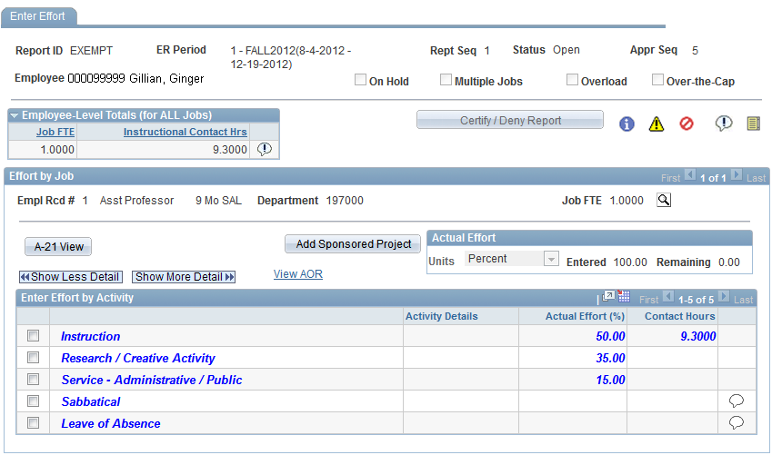
FACET Effort Certification Report
Notes:
Verbatim from law
Explains that non instruction activities which further the mission of FSU are “converted” to contact hours and are allowable under the statute.
“Contact Hour Equivalencies”

Slide 9



FACET Exempt Certification Process
Information Message
Warning Message - allows move to next level
Error Message - needs resolution prior to allowing move to next level

Slide 10
FACET Effort Certification Report
Notes:
Verbatim from law
Explains that non instruction activities which further the mission of FSU are “converted” to contact hours and are allowable under the statute.
“Contact Hour Equivalencies”

Slide 11
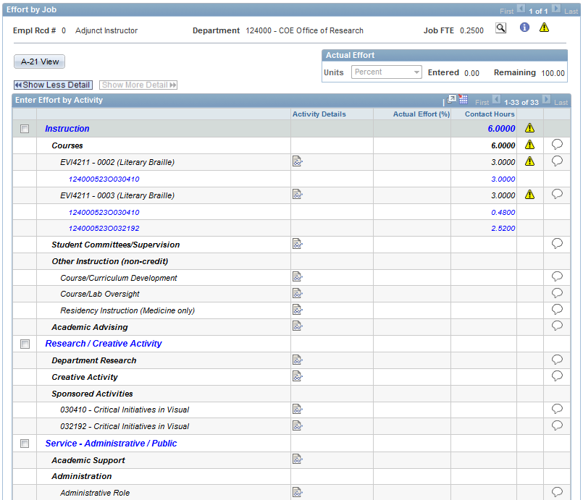
FACET Effort Certification Report
Notes:
Verbatim from law
Explains that non instruction activities which further the mission of FSU are “converted” to contact hours and are allowable under the statute.
“Contact Hour Equivalencies”

Slide 12
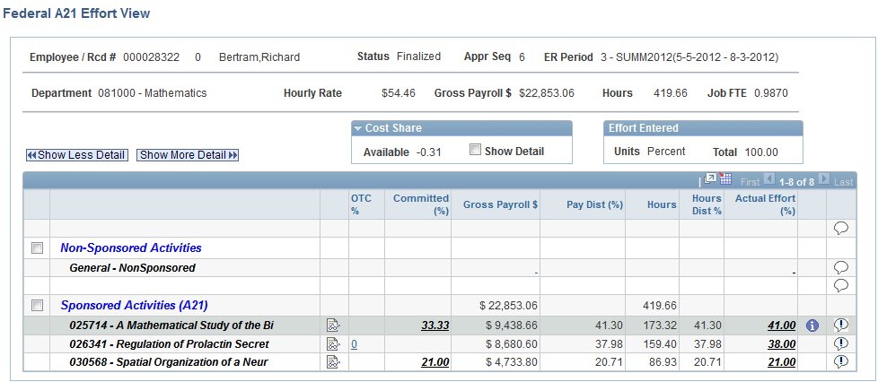
A-21 View
000099999 Ginger Gilligan

Slide 13
Preparing for CERTIFICATION

Slide 14
Preparing for Certification Cycles
Student Central / Course Data
Commitments on Projects
Job Appointments
Assignment of Responsibilities

Slide 15
Preparing for Certification Cycles
Student Central / Course Data
Review data from Student Central in FACET Course Funding Interface.
  No instructor of Record (IOR) assigned
  Payroll/funding errors (instructor must have eligible funding source for Instruction)
  Instructional contact hours over 30 for a person (possible, but unusual)
Notes:
Verbatim from law
Explains that non instruction activities which further the mission of FSU are “converted” to contact hours and are allowable under the statute.
“Contact Hour Equivalencies”

Slide 16
Preparing for Certification Cycles
Commitments on Projects
FSU defines a commitment as:
“Quantified effort for named personnel whether direct charged or cost shared, as specified in the proposal or award.”
Review Sponsored Project Commitments
  Review commitments for new projects, before new appointments to projects, and beginning of semester periods
  Key personnel changes (named in grant) can affect commitment assignments
Notes:
Verbatim from law
Explains that non instruction activities which further the mission of FSU are “converted” to contact hours and are allowable under the statute.
“Contact Hour Equivalencies”

Slide 17
Preparing for Certification Cycles
Commitments on Projects
Key Personnel Definition:
  FSU will follow the sponsoring agency’s definition of Key Personnel if one exists
  If no agency definition exists, FSU will define Key Personnel as the PI and all Co-PIs identified as such in the proposal and/or award
PI’s are encouraged to limit the number of key personnel identified in the proposal
PI’s are encouraged to limit effort commitments that are not paid for by sponsor
Notes:
Verbatim from law
Explains that non instruction activities which further the mission of FSU are “converted” to contact hours and are allowable under the statute.
“Contact Hour Equivalencies”

Slide 18
Preparing for Certification Cycles
Commitments on Projects
Proposal and award are source of commitments
Commitments can be recorded in Budget Forms, Budget Justifications, and Available Resources sections of projects
Commitments are entered for Key Personnel and non-Key Personnel that are cost-shared.
Commitments are entered as percentages of total effort required
Commitment period(s) are Life of Project, Academic Year (Fall, Spring), or Summers Only. The commitments shown in FACET are only for the periods when funding is obligated.
Notes:
Verbatim from law
Explains that non instruction activities which further the mission of FSU are “converted” to contact hours and are allowable under the statute.
“Contact Hour Equivalencies”

Slide 19
Preparing for Certification Cycles
Commitments on Projects
Commitments may be adjusted due to:
  Increase or reduction in funding and/or period of performance
  Changes in scope of work
  Voluntary reduction of effort at PI’s discretion if allowed by terms of the award
As long as the overall commitment is still met, period commitments may be moved to future periods depending on employee availability and schedule.
Notes:
Verbatim from law
Explains that non instruction activities which further the mission of FSU are “converted” to contact hours and are allowable under the statute.
“Contact Hour Equivalencies”

Slide 20
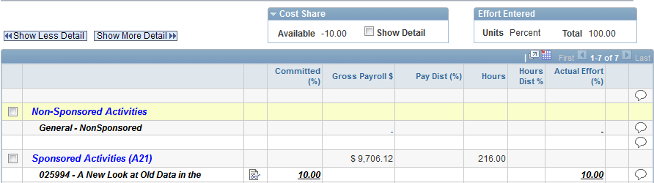
Preparing for Certification Cycles
Commitments on Projects
Commitment Shown in FACET (A-21 Page):
Notes:
Verbatim from law
Explains that non instruction activities which further the mission of FSU are “converted” to contact hours and are allowable under the statute.
“Contact Hour Equivalencies”

Slide 21
Preparing for Certification Cycles
Commitments on Projects
You may request changes to a commitment by sending an Email to Sponsored Research:
    Kaytee Fletcher (kfletcher@fsu.edu)
Notes:
Verbatim from law
Explains that non instruction activities which further the mission of FSU are “converted” to contact hours and are allowable under the statute.
“Contact Hour Equivalencies”

Slide 22
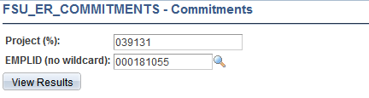
Preparing for Certification Cycles
Commitments on Projects
OMNI Commitment Query: FSU_ER_SRS_CURRENT_COMMITMENTS
Notes:
Verbatim from law
Explains that non instruction activities which further the mission of FSU are “converted” to contact hours and are allowable under the statute.
“Contact Hour Equivalencies”

Slide 23
Preparing for Certification Cycles
Job Appointments
  Verify courtesy appointments are valid for instruction
  Complete all pending position supervisor changes
  Note which individuals in your unit have multiple job records (with you or other departments)
Notes:
Verbatim from law
Explains that non instruction activities which further the mission of FSU are “converted” to contact hours and are allowable under the statute.
“Contact Hour Equivalencies”

Slide 24
Preparing for Certification Cycles
Assignment of Responsibilities
  Estimate of effort a faculty member will work during the upcoming academic year
  Normally completed during Spring semester
  Can be updated as many times as needed
  Is available to review when entering effort into FACET
  FACET must accurately report effort during period. If different from AOR, an AOR amendment is recommended.
Notes:
Verbatim from law
Explains that non instruction activities which further the mission of FSU are “converted” to contact hours and are allowable under the statute.
“Contact Hour Equivalencies”

Slide 25
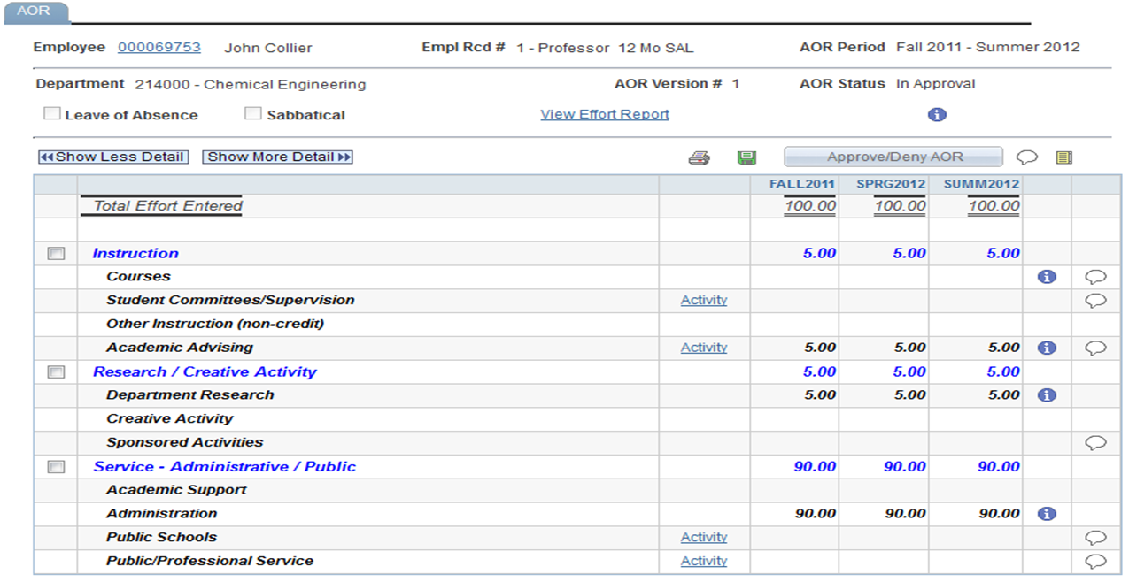
Preparing for Certification Cycles
Assignment of Responsibilities
Notes:
Verbatim from law
Explains that non instruction activities which further the mission of FSU are “converted” to contact hours and are allowable under the statute.
“Contact Hour Equivalencies”

Slide 26
Preparing for Certification Cycles
Important Considerations
  Multiple jobs in different departments will require representatives to coordinate efforts
  Certification non-compliance will require sponsored project charges to be move to another funding source
  Please be proactive about supervisor changes, transfers, and separations.
Notes:
Verbatim from law
Explains that non instruction activities which further the mission of FSU are “converted” to contact hours and are allowable under the statute.
“Contact Hour Equivalencies”

Slide 27
Preparing for Certification Cycles
FACET EXEMPT TIMELINE
FACET Exempt is available for department certification within 60 days after the end of a semester. Openings are announced prior to start date via FACET mailing list.
  Student Central Course Updates Completed by Final Day of the Semester
  Alternate Path Reports Available 7 Days Prior to Open Date
  Employee/Supervisor Deadline for Report Certification (Level 4) is 14 Days after Open Date
  Certification Deadline is 21 Days (3 weeks) after Open Date

Slide 28
Preparing for Certification Cycles
FACET Department Representative Roles
  New Department Representatives must request the FSU_FACET_REP role from the OMNI eORR system (under Human Resources roles)
  Representatives must also be added to the OMNI Department Representative table.
Notes:
Verbatim from law
Explains that non instruction activities which further the mission of FSU are “converted” to contact hours and are allowable under the statute.
“Contact Hour Equivalencies”

Slide 29
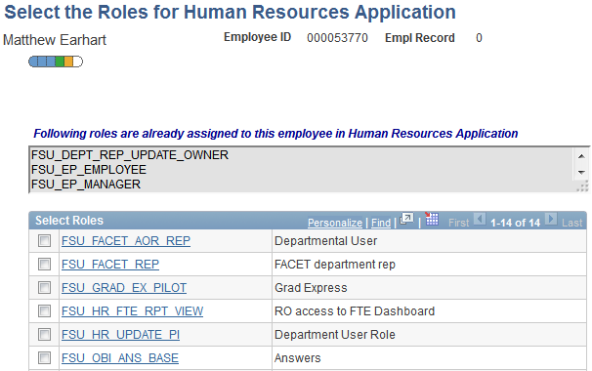
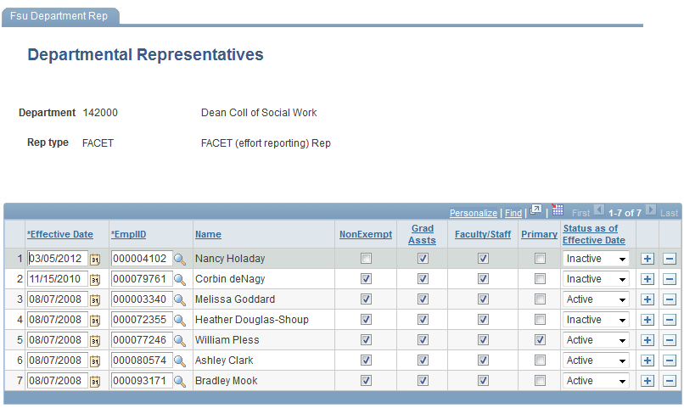
Preparing for Certification Cycles
FACET Department Representative Roles
Notes:
Verbatim from law
Explains that non instruction activities which further the mission of FSU are “converted” to contact hours and are allowable under the statute.
“Contact Hour Equivalencies”

Slide 30
Preparing for Certification Cycles
FACET Department Team
FACET Exempt Rep.
Time/Labor Rep.
Course Schedule Rep.
Grants Compliance Rep.
HR/Appointment Rep.

Slide 31
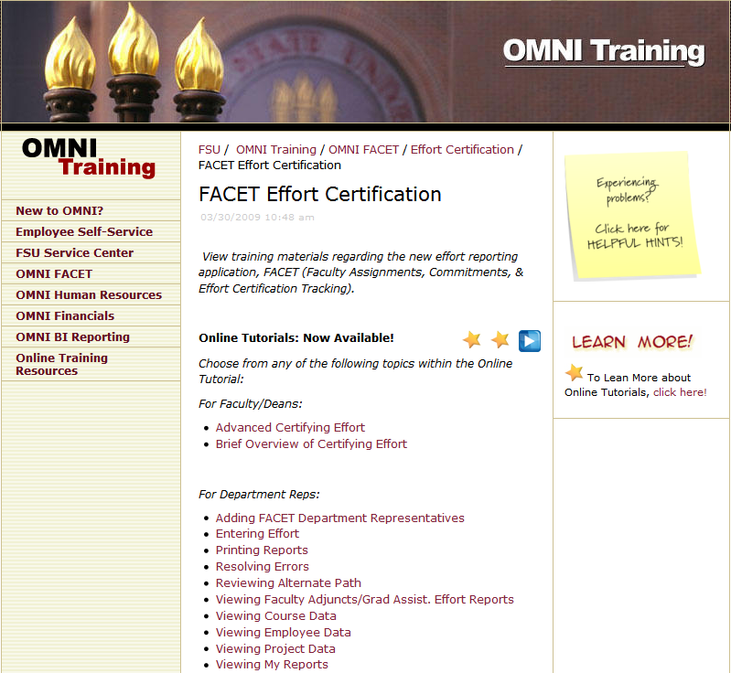
Preparing for Certification Cycles
Training Materials
A complete set of training materials for department representatives and individuals required to certify effort can be located at:
http://omni.training.fsu.edu/OMNI-FACET/Effort-Certification/FACET-Effort-Certification

Slide 32
Effort Certification
PROCESS

Slide 33
FACET Exempt Certification Process
Level 1: ERP
Level 2: IR
Level 3: FACET REP
Level 4: Employee/KP
Level 5: Review/Error Resolution
Level 6: Final

Slide 34
FACET Exempt Certification Process
Effort Categories
Each Empl Rcd must have 100% effort entered, whole numbers ONLY (no decimals)
Department Representatives: You can only enter effort for records in your department
Employees can enter effort on all their records
Be alert to icons: Errors, Warnings, Information

Slide 35
FACET Exempt Certification Process
“Instruction” Section
Displays for-credit courses
  Instructor of Record
  Contact Hours
Enter total effort at Courses Activity Level
Effort automatically distributes to listed courses (use Show More Detail to see individual courses)

Slide 36
FACET Exempt Certification Process
Notes:
Verbatim from law
Explains that non instruction activities which further the mission of FSU are “converted” to contact hours and are allowable under the statute.
“Contact Hour Equivalencies”

Slide 37
FACET Exempt Certification Process
Courses Funded by Sponsored Projects
Courses can be funded by a grant if:
  Award purpose is INS
  Award purpose is RES or OSA and:
    Course Section Type is Graduate Dissertation, Graduate Thesis, Supervised Research or DIS (or)
    An Instruction attribute has been added to the project: Instruction Allowed or Cost Share Instruction Allowed

Slide 38
FACET Exempt Certification Process
“Research/Creative Activity” Section
Enter effort individually for each listed project
  If sponsored project not displayed, project will have to be added using Add Sponsored Project button (can be done at Level 3 or 4)
Project will automatically display on FACET report if:
  Commitment entered for academic term
  Salary funded from project

Slide 39
FACET Exempt Certification Process
Notes:
Verbatim from law
Explains that non instruction activities which further the mission of FSU are “converted” to contact hours and are allowable under the statute.
“Contact Hour Equivalencies”

Slide 40
FACET Exempt Certification Process
A-21 View Page
Effort entered on previous page “transfers” to A-21 View page
Displays/compares commitments, funding, and entered effort
System automatically allocates to:
  Direct Charge Salary, Committed Cost Sharing, Over the Salary Cap, Uncommitted Cost Sharing

Slide 41
FACET Exempt Certification Process
000099999 Ginger Gilligan

Slide 42
FACET Exempt Certification Process
Changes to Certified Effort
Certified effort reports assert that the entered information is accurate and complete to the best of the certifier’s knowledge
Changes to previously certified effort erode the credibility of the certifier and present serious issues during external audits
In the FACET system, retroactive funding adjustments after certification will trigger the need to re-certify an effort report

Slide 43
FACET Exempt Certification Process
Changes to Certified Effort
Once a report has been certified and moved to Level 5, we recommend resolving any issues without pushing report back to Level 4 whenever possible.

Slide 44
ISSUES RESOLUTION

Slide 45
Issues Resolution
Common FACET Error Numbers
Error Number | Error Name | Resolution Notes | Error Support Staff
1020 | Payroll Distribution Percentage Cannot be Negative | A payroll correction may need to be processed. | Contact: FACET Support Team (facet@fsu.edu)
1021 | Payroll distribution percentage cannot be negative | A Warning for the E/KP as they are expected to enter their actual effort. The Dept Rep is responsible for making any payroll correction(s) required as a result of effort entered. | Contact: FACET Support Team (facet@fsu.edu)

Slide 46
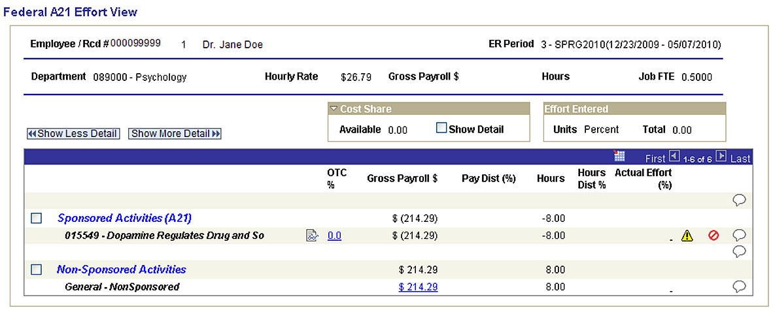
Issues Resolution
1020/1021 Error: Negative Payroll Distribution

Slide 47
Issues Resolution
Common FACET Error Numbers
Error Number | Error Name | Resolution Notes | Error Support Staff
1030 | Effort not sufficient to meet Pay Distribution | A warning for the E/KP since they are expected to enter their actual effort. The FACET rep is responsible for any payroll correction(s) required as a result of effort entered. | Contact: SRAS Dept Coordinator or FACET Support Team
1040 | Effort entered not sufficient to cover required over the salary cap cost share | A payroll correction needs to be processed to allocate OTC amount – requires cost share budget. | SRAS Department Coordinator
Note: 1030 Error may occur when there is a change to a project’s purpose code. Please contact the FACET Support Team if you believed this has occurred.

Slide 48
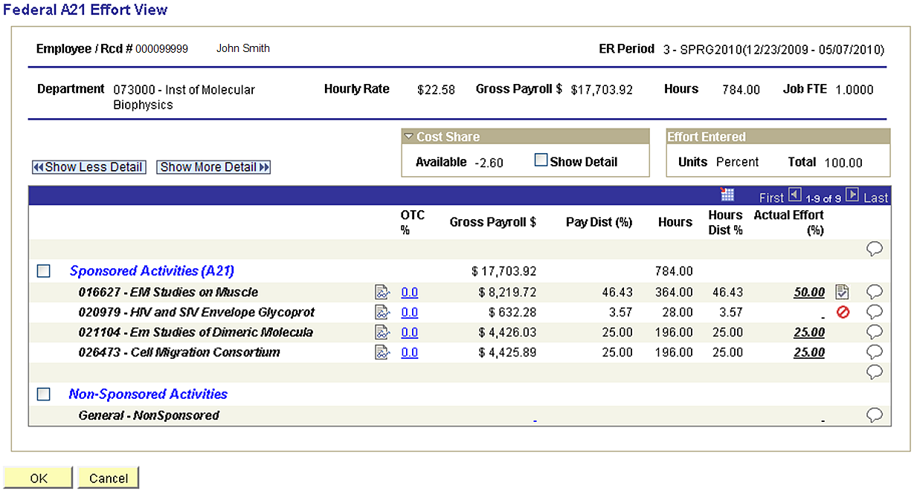
Issues Resolution
1030 Error: Effort Not Sufficient for Pay Distribution

Slide 49
Issues Resolution
Common FACET Error Numbers
Error Number | Error Name | Resolution Notes | Error Support Staff
1050 | Pay occurs on this project prior to the project start date | Error also triggered when an RDFF affects the pay period that includes the project start date. | Contact SRAS Department Representative or FACET Support Team
1060 | Pay occurs on this project after the project end date | Error also triggered when a personnel appointment (including RDF) affects the pay period that includes the project end date. | Contact SRAS Department Representative or FACET Support Team

Slide 50
Issues Resolution
1050/1060 Error: Pay Occurs Before/After Project Dates

Slide 51
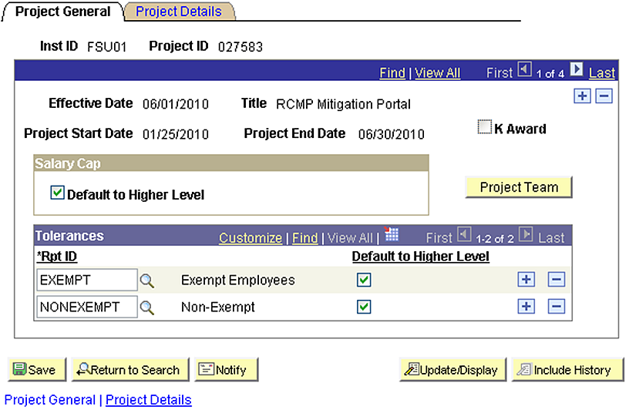
Issues Resolution
1050/1060 Error: Pay Occurs Before/After Project Dates

Slide 52
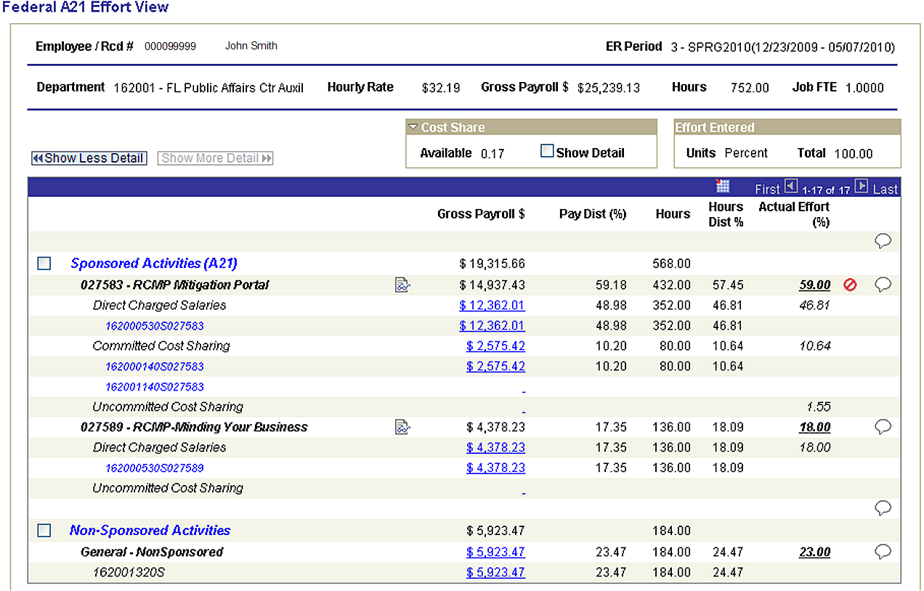
Issues Resolution
1050/1060 Error: Pay Occurs Before/After Project Dates

Slide 53
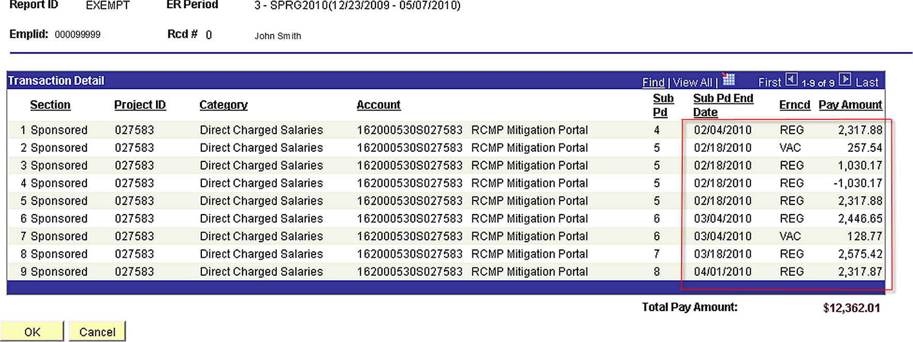
Issues Resolution
1050/1060 Error: Pay Occurs Before/After Project Dates

Slide 54
Issues Resolution
Common FACET Error Numbers
Error Number | Error Name | Resolution Notes | Error Support Staff
1120 | Effort entered is less than commitment | Contact SRAS to correct/adjust commitment in future periods | SR: Kaytee Fletcher

Slide 55
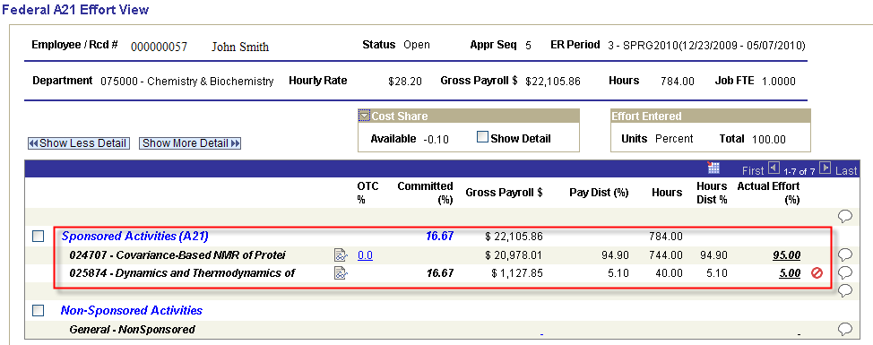
Issue Resolution
1120 Error: Effort Entered is Less Than Commitment

Slide 56
Issues Resolution
Issue Resolution Contacts
General FACET Questions
  Department Representative (recommended starting point for staff/faculty)
  FACET Support Team (facet@fsu.edu)
Sponsored Research Questions (Commitments, Sponsored Funds, etc.)
  Your SRA Coordinator
  Commitment Issues: Kaytee Fletcher (kfletcher@fsu.edu)

Slide 57
Additional Contacts
Institutional Research | Phone | Email
FACET Support Team | N/A | facet@fsu.edu
Rick Burnette | 644-1532 | rburnette@admin.fsu.edu
Matthew Earhart | 644-0398 | mearhart@admin.fsu.edu
Mev Verzaal | 645-0285 | mverzaal@admin.fsu.edu
Sponsored Research Administration | Phone | Email
Diana Key | 644-8648 | dkey@admin.fsu.edu
Kaytee Fletcher | 645-1947 | kfletcher@admin.fsu.edu

Slide 58
References
OMB Circular A-21
  http://www.whitehouse.gov/omb/circulars_a021_2004/
FSU Effort Commitment Policy
  http://www.research.fsu.edu/contractsgrants/documents/effcomm.pdf
Effort Commitments During No-Cost Extension Periods
  http://www.research.fsu.edu/contractsgrants/documents/effort_nocost.pdf
Effort Commitment Data Entry in FACET
  http://www.research.fsu.edu/contractsgrants/documents/effentry.pdf
FSU Cost Sharing Policy
  http://www.research.fsu.edu/contractsgrants/costsharing.html
FSU Campus Cost Sharing Procedures
  http://www.research.fsu.edu/contractsgrants/documents/csprocedures.pdf

Slide 60
FACET NON-Exempt
Effort Reporting OVERVIEW

Slide 61
Non-Exempt Effort Reporting Overview
Differences between Exempt and Non-Exempt certification?
  Reporting effort hours instead of percentages
    1 hour tolerance on NX reports
  Reports are certified monthly
    Reports rely on timely timesheet submissions
    Hours are based on pay periods, not calendar month
Notes:
Demonstrate compliance effort committed (funded or otherwise)

Slide 62
Inputs from Campus Systems
FACET
NX
Employee Data
Payroll Data
Sponsored Project Data

Slide 63
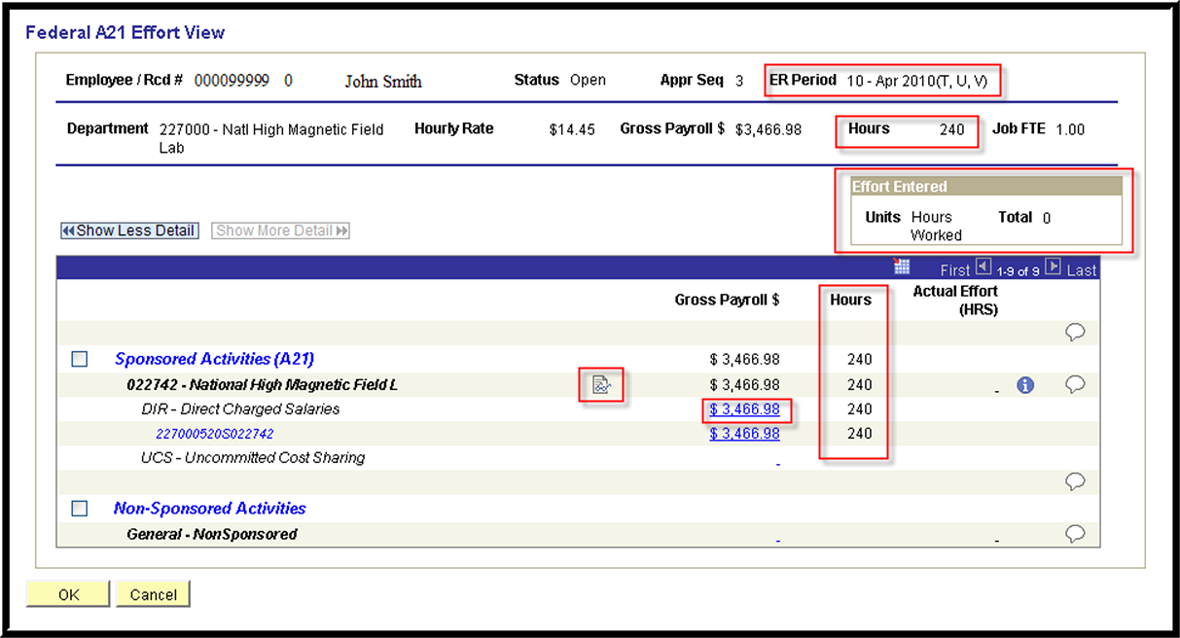
FACET NX A-21 View Page

Slide 64
Preparing for CERTIFICATION

Slide 65
Preparing for Certification Cycles
Important Considerations for NX Certification
  Timeliness of certification is extremely important!
  Non-Exempt employees not having FSUIDs or OMNI system access
  Payroll corrections effecting prior reporting periods
  One Time Pays not allowed on NX appointments (1022 Errors)
Notes:
Demonstrate compliance effort committed (funded or otherwise)

Slide 66
Preparing for Certification Cycles
Important Considerations for NX Certification
  Timesheets 90 days past due (per HR deadlines) will require cost transfers to add charges to sponsored projects
  Multiple jobs in different departments will require representatives to coordinate efforts
  Certification non-compliance will require sponsored project charges to be move to another funding source
  Please be proactive about supervisor changes, transfers, and separations.
Notes:
Demonstrate compliance effort committed (funded or otherwise)

Slide 67
Preparing for Certification Cycles
FACET NON-EXEMPT TIMELINE
FACET Non-Exempt is available for department certification 28 days after the last pay period on the report. Opening will be announced prior to start date via FACET mailing list.
Deadline for completion (Level 6) is 14 days after NX period opens to campus.

Slide 68
Preparing for Certification Cycles
FACET Department Team
FACET Non-Exempt Rep.
Time/Labor Rep.
Grants Compliance Rep.
HR/Appointment Rep.

Slide 69
Effort Certification
PROCESS

Slide 70
FACET Non-Exempt Certification Process
Level 1: ERP
Level 2: IR
Level 3: NX REP
Level 4: Employee/KP
Level 5: NX Rep (Error Resolution)
Level 6: IR/Final

Slide 71
FACET Non-Exempt Workflow
Level 1: ERP
Level 2: IR
Level 3: NX REP
Level 4: Employee/KP
Level 5: NX Rep
Level 6: IR/Final
Error(s)

Slide 72
ISSUES RESOLUTION

Slide 73
Issues Resolution
Common FACET Error Numbers
Error Number | Error Message | Resolution Notes
1022 | Salary paid on funding source with no hours associated | Review payroll records to determine if this error is due to a One-time pay transaction.
1031 | Effort Hours entered are not sufficient to cover funded hours | Entered effort must cover the funded hours.
1032 | Effort Hours entered exceed funded hours | Review payroll records and timesheets to determine if a timesheet has not been processed.

Slide 74
Issues Resolution
Common FACET Error Numbers
Error Number | Error Message | Resolution Notes
1140 | The project is not 'sponsored’ | Enter effort in the 'Other Non-Sponsored Activities' Section
1180 | Effort must be entered as whole numbers | Enter effort in whole numbers.

